Slide 1
Percutaneous treatment for Mitral Regurgitation
Presenter
Dr. Benny J. Panakkal
Senior Resident
Dept. of Cardiology
Govt. Medical College, Kozhikode.

Slide 2
Transcatheter Mitral Valve Repair
TMVR_{e}

Slide 3
Overview
APPROACH | DEVICE
LEAFLET REPAIR | MITRACIP
 | MOBIUS
CORONARY SINUS ANNULOPLASTY | CARILLON
 | PTMA
 | MONARC
ATRIAL REMODELLING | PS³
 | PMVR
DIRECT ANNULOPLASTY | MITRALIGN
 | ACCUCINCH
 | QUANTUMCOR
 | HYBRID APPROACH
VENTRICULAR REMODELLING | iCOAPSYS
 | Mardil-BACE
CHORDAL IMPLANTATION | MITRAFLEX
 | NEOCHORD
 | BABIC

Slide 4
Leaflet Repair

Slide 5
MitraClip
Leaflet Repair
Notes:
Mitraclip device with Evalve delivery system→ Alfieri repair
EVEREST I AND II trials: exclusion of patients with severe LV dys or annular dilatation→means only sev degenerative MR patients were studied.
EVEREST II randomized patients in 2:1 ration to mitraclip vs surgery

Slide 6
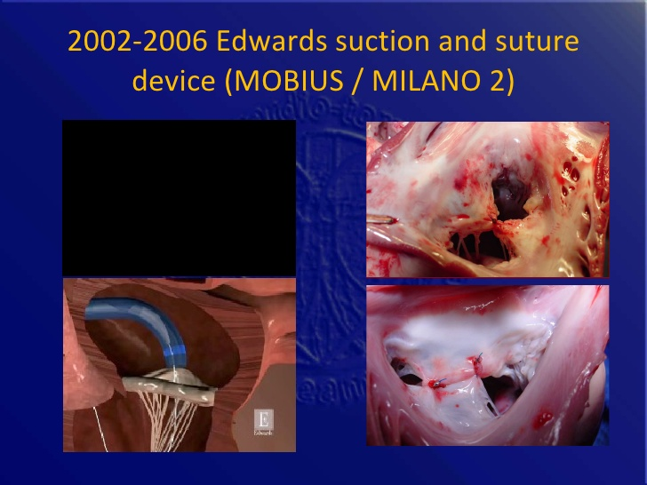
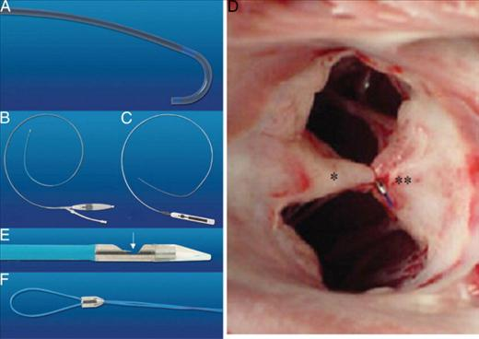
Mobius
Leaflet Repair
Notes:
Milano II trial→ very complex procedure, hence abandoned plans to pursue. Variable results.

Slide 7
Coronary Sinus Annuloplasty

Slide 8
Carillon
Coronary Sinus Annuloplasty
Notes:
Proximal and distal nitinol self expanding anchors
Steel bridge→manual tension given
Anchor slippage a big problem
CARILLON XE→ modified device→ AMADEUS Trial→ reduction in MR and clinical benefit.

Slide 9
Percutaneous Transvenous Mitral Annuloplasty Device [PTMA]
Coronary Sinus Annuloplasty
Notes:
Metal rods inserted into the coronary sinus→intention to deflect the post portion of mitral annulus anteriorly.

Slide 10
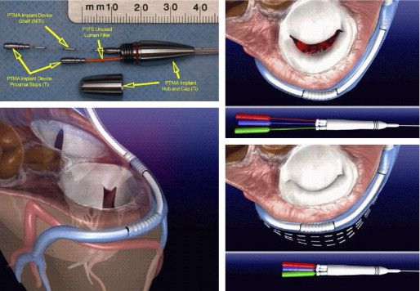
Percutaneous Transvenous Mitral Annuloplasty Device [PTMA]
Coronary Sinus Annuloplasty
Notes:
PTOLEMY trial → 19 patients→ limited durability and reduction in grade of MR

Slide 11
Monarc
Coronary Sinus Annuloplasty
Notes:
Proximal and distal stent like anchors.
Nitinol bridge segement→constructed like a spring with biodegradable spacers→shortens with time→both acute and delayed effect

Slide 12
Monarc
Coronary Sinus Annuloplasty
Notes:
Anatomical considerations
Crossing over LCx and branches→ischemia
More towards atrial side
Coronary sinus lead implantation may cause issues

Slide 13
Monarc
Coronary Sinus Annuloplasty
Notes:
EVOLUTION I → Feasibility trial
EVOLUTION II → Safety and efficacy of MONARC in grade 3&4 functional MR

Slide 14
Atrial Remodelling Devices

Slide 15
Percutaneous Septal Shortening System [PS³]
Atrial Remodelling Devices
Notes:
Anchors in great cardiac vein and second in IAS fossa ovalis. Magnetic wire delivery system and traction reduces AP diameter of annulus.

Slide 16
Percutaneous Mitral Repair Device
[St. Jude Device]
Atrial Remodelling Devices
Notes:
Distal anchors in mitral annulus adjacent to P2 scallop
Proximal anchors in RA near posteromedial trigone
Tether→polyester

Slide 17
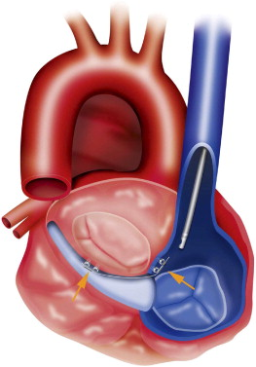
Percutaneous Mitral Repair Device
[St. Jude Device]
Atrial Remodelling Devices

Slide 18
Direct Annuloplasty

Slide 19
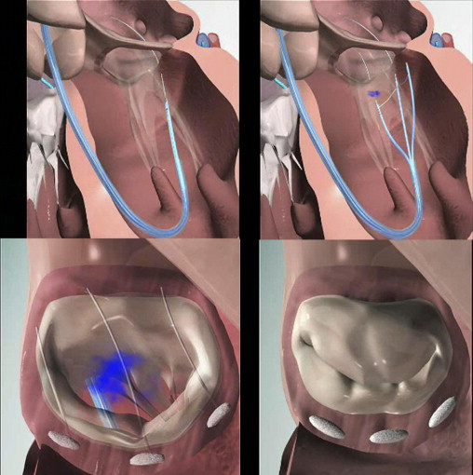
Mitralign
Direct Annuloplasty
Notes:
Only 3 anchors in the post annulus. Initially developed as a transapical approach, now transaortic approach available.

Slide 20
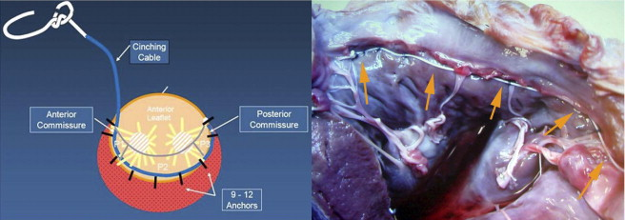
Accucinch
Direct Annuloplasty
Notes:
Almost entire mitral annulus is encircled with anchors and tightened

Slide 21
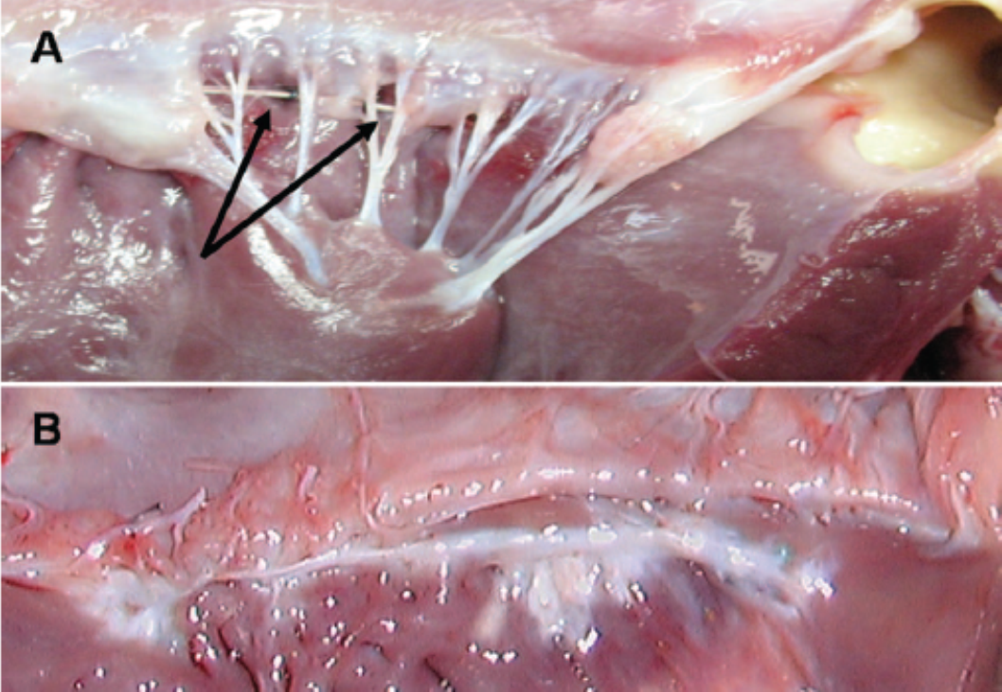
Accucinch
Direct Annuloplasty

Slide 22
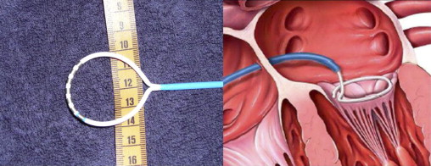
QuantumCor
Direct Annuloplasty
Notes:
High frequency focussed ultrasound → annular collage tissue heating and subsequent shrinkage

Slide 23
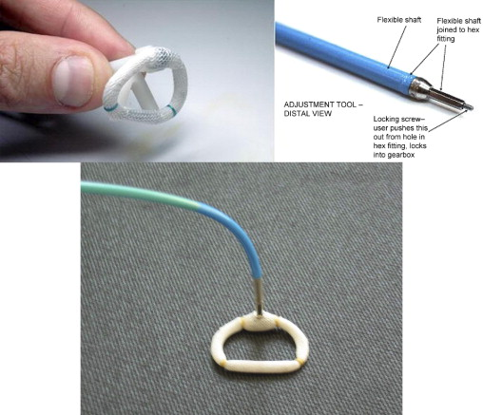
Direct annuloplasty : Hybrid approach
Direct Annuloplasty
Notes:
Surgically implanted annuloplasty ring
Percutaneously adjusted via trans-septal approach to tighten

Slide 24
Ventricular Remodelling devices

Slide 25
iCoapsys
Ventricular Remodelling Devices
Notes:
Coapsys→surgically implanted version of this device
TRACE (feasibility) & RESTORE-MV (RCT) trials
iCoapsys→percutaneous version→inserted via Subxiphoid pericardial access sheath

Slide 26
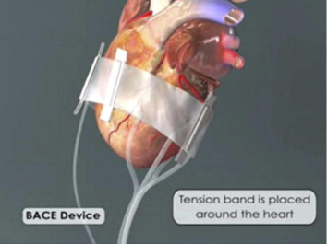
Mardil-BACE
Ventricular Remodelling Devices
Notes:
Requires mini-thoracotomy. Silicone band placed around mitral annulus with inflatable portions to ↑ tension.
No coronary artery compromise shown in animal models.

Slide 27
Transcatheter Chordal Implants

Slide 28
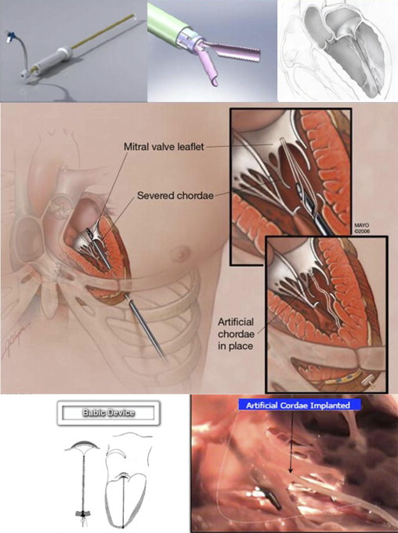
MitraFlex; NeoChord; Babic
Transcatheter Chordal Implants
MitraFlex
NeoChord
Babic
Notes:
MitraFlex & NeoChord→ transapical placement of anchors on LV wall and leaflet, connected by an artificial chordae
Babic → transapical insertion of a suture through the leaflet, exteriorized via trans-septal approach from venous side to insert an pledget→apposed to leaflet by pulling guiding sutures from the epicardial end.

Slide 29
Transcatheter Mitral Valve replacement
TMVR

Slide 30
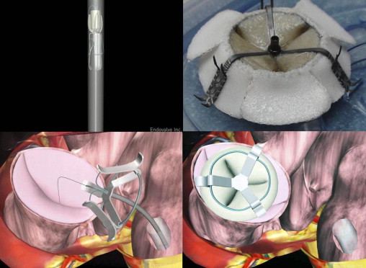
Endovalve-Herrmann prosthesis
TMV Replacement
Notes:
One of the first devices designed
Now undergoing redesign→permaseal technology to facilitate transapical approach. (sutureless wound closure)

Slide 31
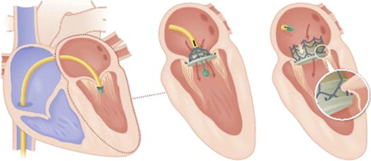
CardiAQ
TMV Replacement
Notes:
Self expanding nitinot frame→ 3 leaflets of bovine pericardial tissue
No radial force on annulus, the anchors clinch the mitral valve from the LA and LV side, foreshortening of the anchor causes a clamping action.
Readjustable before final deployement.
2 percutaneous approaches→transpical and transvenous septal puncture.

Slide 32
CardiAQ
TMV Replacement

Slide 33
Tiara valve
TMV Replacement
Notes:
Self expanding bioprosthesis with bovine pericardial tissue leaflets
D-shaped→matches annulus
Transapical approach → 32F delivery sheath

Slide 34
Tendyne valve
TMV Replacement
Notes:
Trileaflet pericardial valve with nitinol frame
Transapical approach with neochordae attachement.
D-shaped designs were tried but failed due to reorientation of the valve and ↑ paravalvular leak

Slide 35
Medtronic-TMV
TMV Replacement
Notes:
Trileaflet pericardial valve
Large atrial portion and small ventricular portion to minimize LVOT obstruction.
No radial force, uses MV leaflets for anchorage.
Delivered transatrially. Transseptal delivery under development.

Slide 36
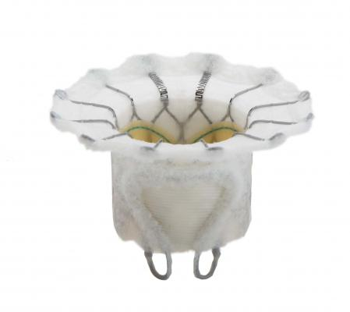
Fortis TMV
TMV Replacement
Notes:
Cloth covered self expanding nitinol frame to minimize PVL.
Enrollment for trial halted due to ↑ valve thrombosis.

Slide 37
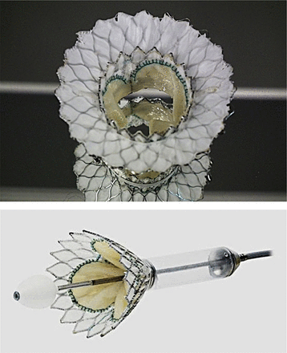
Cardiovalve
TMV Replacement
Notes:
Valtech company
Transfemoral route
2 step approach→first sealing polyester skirt, second the actual valve implantation.

Slide 38
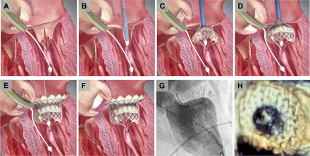
Highlife Medical - TMV
TMV Replacement
Notes:
Transfemoral approach
2 step procedure
A&B→placing a locking component in subannular space→transfemoral route
C-F→transatrial route

Slide 39
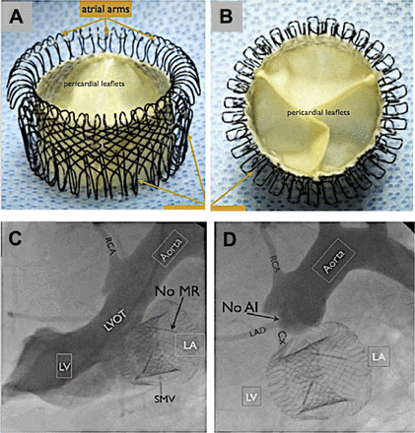
Gorman - TMV
TMV Replacement
Notes:
Single nitinol wire woven into complex 3D structure, porcine pericardium valve
Requires both radial force and valve gripping anchors

Slide 40
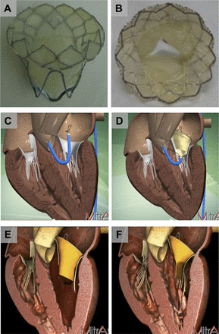
MitrAssist
TMV Replacement
Notes:
Israel
Neither repair nor replacement→works in unison with native mitral valve.
Nitinol frame, pericardial bileaflet tissue valve (asymmetrical design).
Transfemoral transaortic route.
Probably suitable for all types of MR
>90% closure distance promoted by native mitral valves
>80% LV pressure acting on native mitral apparatus

Slide 41
THANK YOU

